Slide 1

Gordo Bot:
Project Proposal
Team 6:
Zachary Laguna, Raney Ankele, Reid Morse, Cody Nguyen, Thomas Rod, and Nicholas Soliman

Slide 2
Overview
Problem Background
Needs Statement
Goals and Objectives
Design Constraints and Feasibility
Literature Review
Evaluation of Alternatives
Proposed Design
Approach for Design Validation
Budget and Economic Analysis
Schedule of Tasks
Project Management and Teamwork
Society, Safety, and Environmental Analysis
Q/A

Slide 3
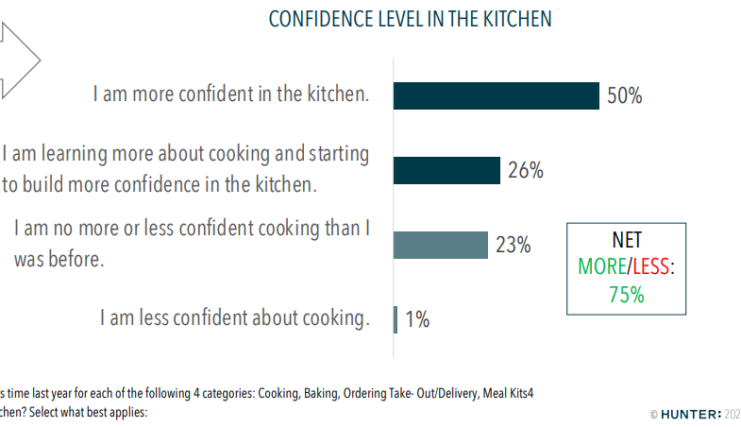
Problem Background
According to a study done with 1000 Americans, cooking at home is becoming more appealing
71% say they will continue to cook at home after the pandemic
67% to save money
56% to eat healthier
56% to feel good
Consumer culture promotes us to order out
More expensive but the process is simpler

Slide 4
Needs Statement
How can we make cooking more appealing to new cooks?
How can we make cooking easier on cooks that struggle following complicated recipes?
How can we make measuring simpler and adding ingredients more efficient?

Slide 5
Objectives and Goals
Assist amateur cooks with prepping and preparing recipes so that the cook can focus on the actual cooking
Easy to use; not technically challenging
Reduce complexity by making cooking prep more efficient
At minimum, pull and display recipes to the user
Ideally, the user can access many recipes and, using a raspberry pi and sensors, dispense the proper amount of ingredients
Stretch goals include accounts that allow saving recipes and tracking statistics related to a specific user’s cooking habits.

Slide 6
Design Constraints & Feasibility
Need to account for the difference between solid and liquid ingredients
Accuracy of sensors could affect recipes
Device should be the size of the average kitchen appliance due to limited counter space
Needs to be affordable
Hardware speed and Raspberry computing have a inevitable overhead
May be a challenge to properly power all components
Recipes will be specifically chosen or scraped for (time permitting)
Web app to interfaces with devices
Time frame determines stretch goals

Slide 7
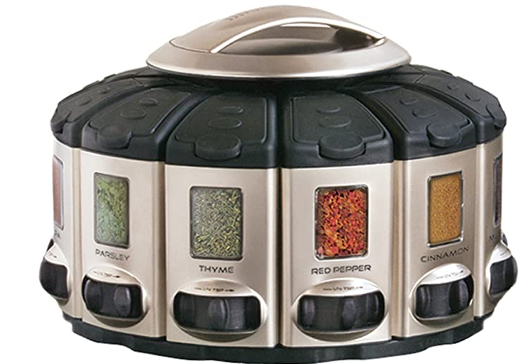
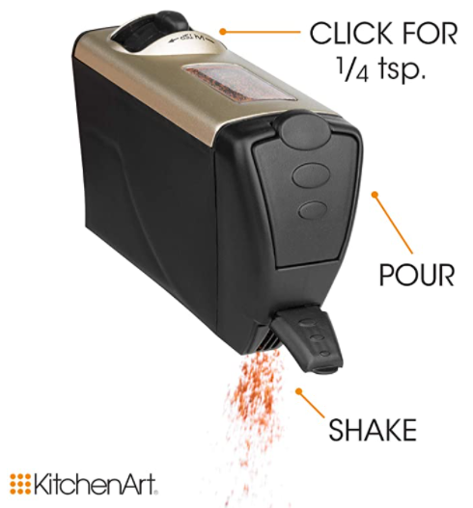
Literature Review
The most common types of tools used for measuring come in sets involving many pieces.
There are also some adjustable measuring tools to reduce the number of pieces needed.
The most impressive competing product found is called the Select-A-Spice Auto-Measure Carousel. However, the scope is limited to spices only.

Slide 8
Alternative Solutions
Buy some combination of existing products
Simpler functions
Separate pieces
Lacks automation and smart functions
Rate of Flow tool
Smart tool determines when to stop based on calculations from flow rate
Less smart functions
High possibility of unforeseen error in design
Speech Recognition Adjustable
Smart tool improvement on existing product
Not as smart as desired for our product
Kitchen All-In-One
Includes wide variety of features
Extremely useful, but fails time constraint
Linear Storage
Placed accessories in linear format
Used too much space, will do circular format to conserve countertop space where needed

Slide 9
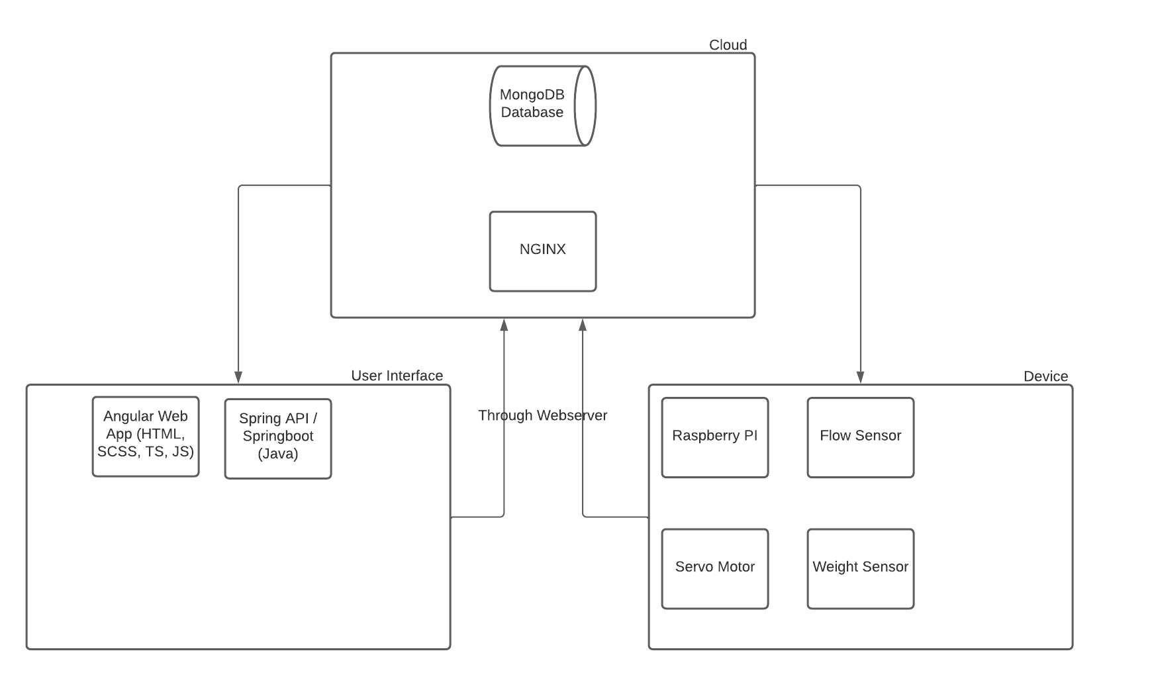
High-Level Design

Slide 10
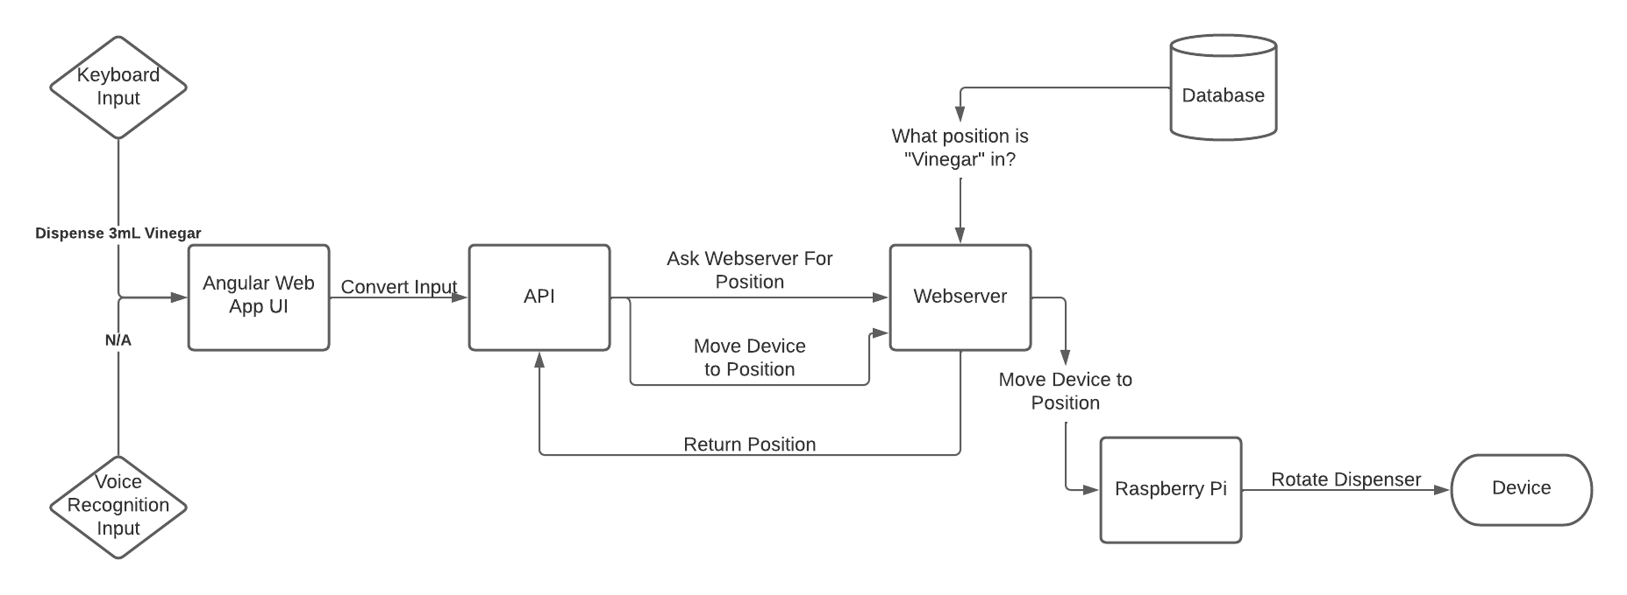

Slide 11
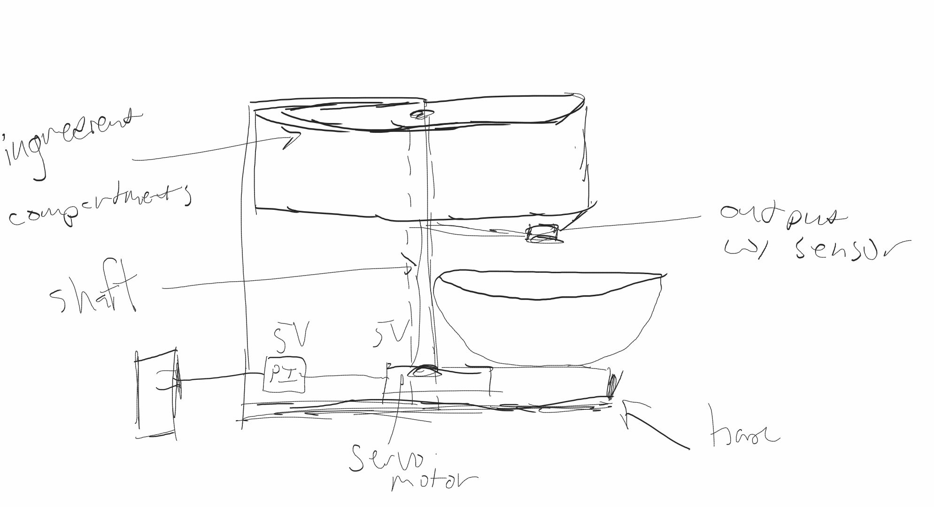
Initial Device Design

Slide 12
Design Validation
Each component must be individually tested and calibrated before integration
Test cases and code will be made for each software feature, repeated after each significant change
Bottom-up approach to build, test, then slowly integrate modules and test again
Must complete tasks unassisted, i.e. no help during set task
Must complete tasks in a timely manner
Must complete tasks efficiently
Must have sustainable structure which can be easily maintained

Slide 13
Budget
Item | Count | Cost
Raspberry Pi | 1 | -
Servo Motor (high torque) | 1 | $ 17.00
Wires | 1 | $ 12.99
Wire Stripper | 1 | $ 6.99
Plexiglass | 3 | $ 45.00
3D Print Base |  | -
Soldering Kit | 1 | -
Lazy Susan | 1 | $ 34.00
Acrylic Cement | 2 | $ 14.00
ProCare® Food Safe Waterproof Fabric (W-443) | 2 | $ 36.00
Flow Meter | 1 | $ 9.00
Weight Sensor | 1 | $ 13.00
Solenoid Valve | 1 | $ 11.00

Slide 14
Economic Analysis
Most parts available at several vendors
Part shortage unlikely
Measurement of error around the axle and output valve are most sensitive to error
Other portions are mostly malleable
Correct alignment is critical, may acquire additional costs due to errors in production

Slide 15
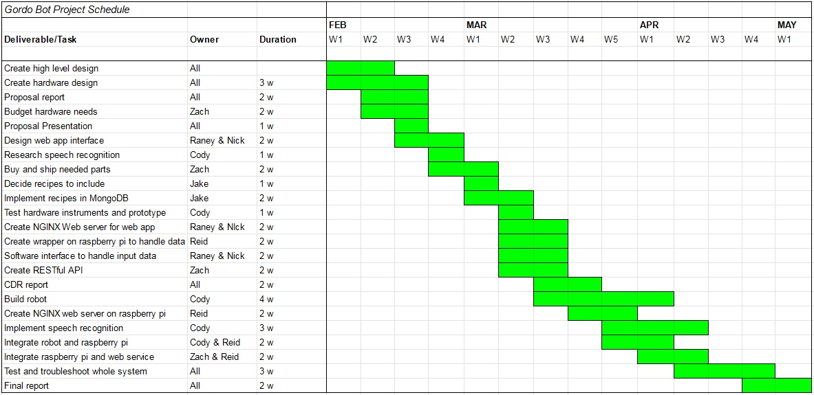
Schedule of Tasks

Slide 16
Project Management and Teamwork
Primary method: Agile Development using Jira, Google Drive, and GitHub to organize
The following are the assigned areas of responsibility in the project, but jobs will often overlap to support each other.
Reid: integration of hardware and software
Cody: hardware and sensors, meeting notes
Jake: cloud services and interface communication
Raney & Nick: interface design
Zach: API usage in Pi functions

Slide 17
Societal, Safety, & Environmental Analysis
More at-home meals would improve quality of life and would help save money
Food business could be hurt by this loss, but it is unlikely to be a substantial influence
Possible promotion in cultural diversity if users browse many recipes to use
App will store food preferences, non-critical
Device may use speech recognition, which could be considered a breach of privacy
Low probability of harm to user, so long as materials aren’t rough/sharp and safe to food
Fixed range of motion minimizes possible damage to surroundings of device
Low environmental impact, uses outlet instead of batteries

Slide 18
Questions, Comments, Concerns?

